Slide 1
RISCV Checkpoint
吳建翰、周光照、鄭謹譯
2020.06.11

Slide 2
Outline
1
Baseline : Current Design
2
Extension : Our Ideas
3
Timeline and Assignment

Slide 3
Baseline
Pipeline
Structure
Forwarding
Unit
Hazard
Unit
L1
Cache

Slide 4
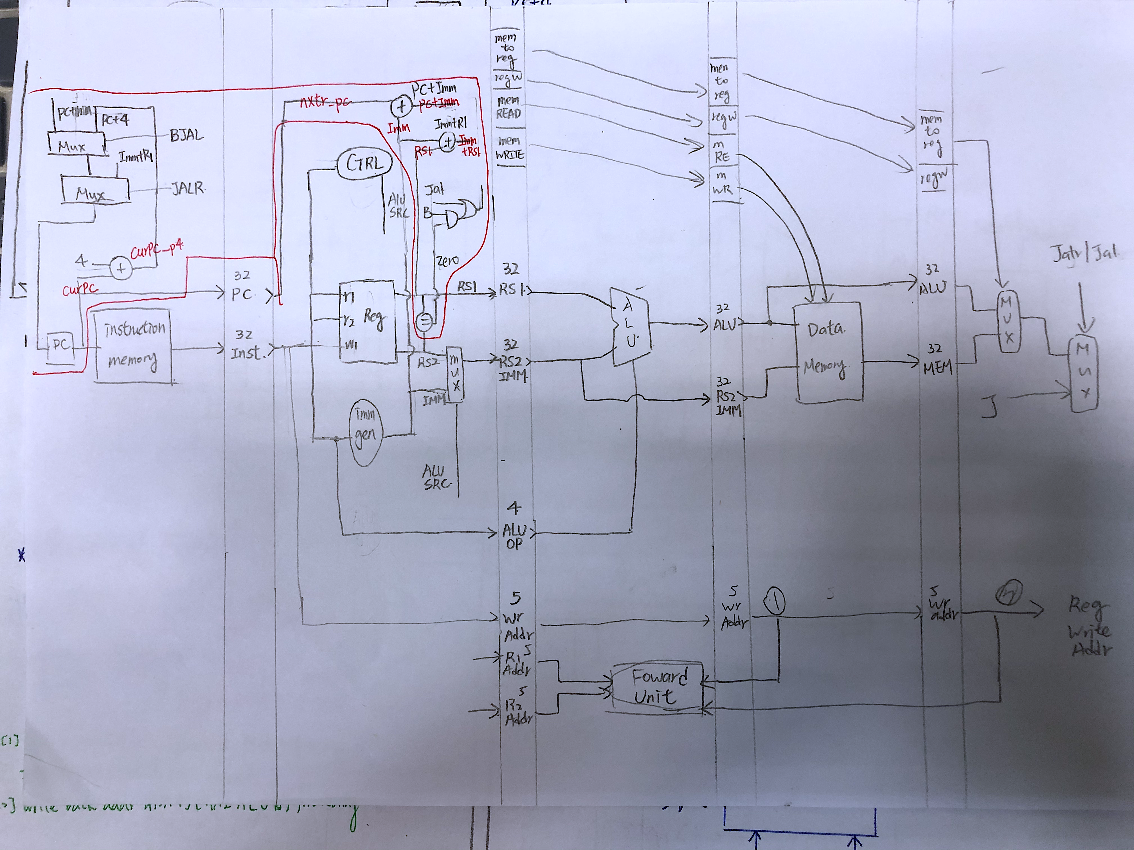
Baseline Structure V1

Slide 5
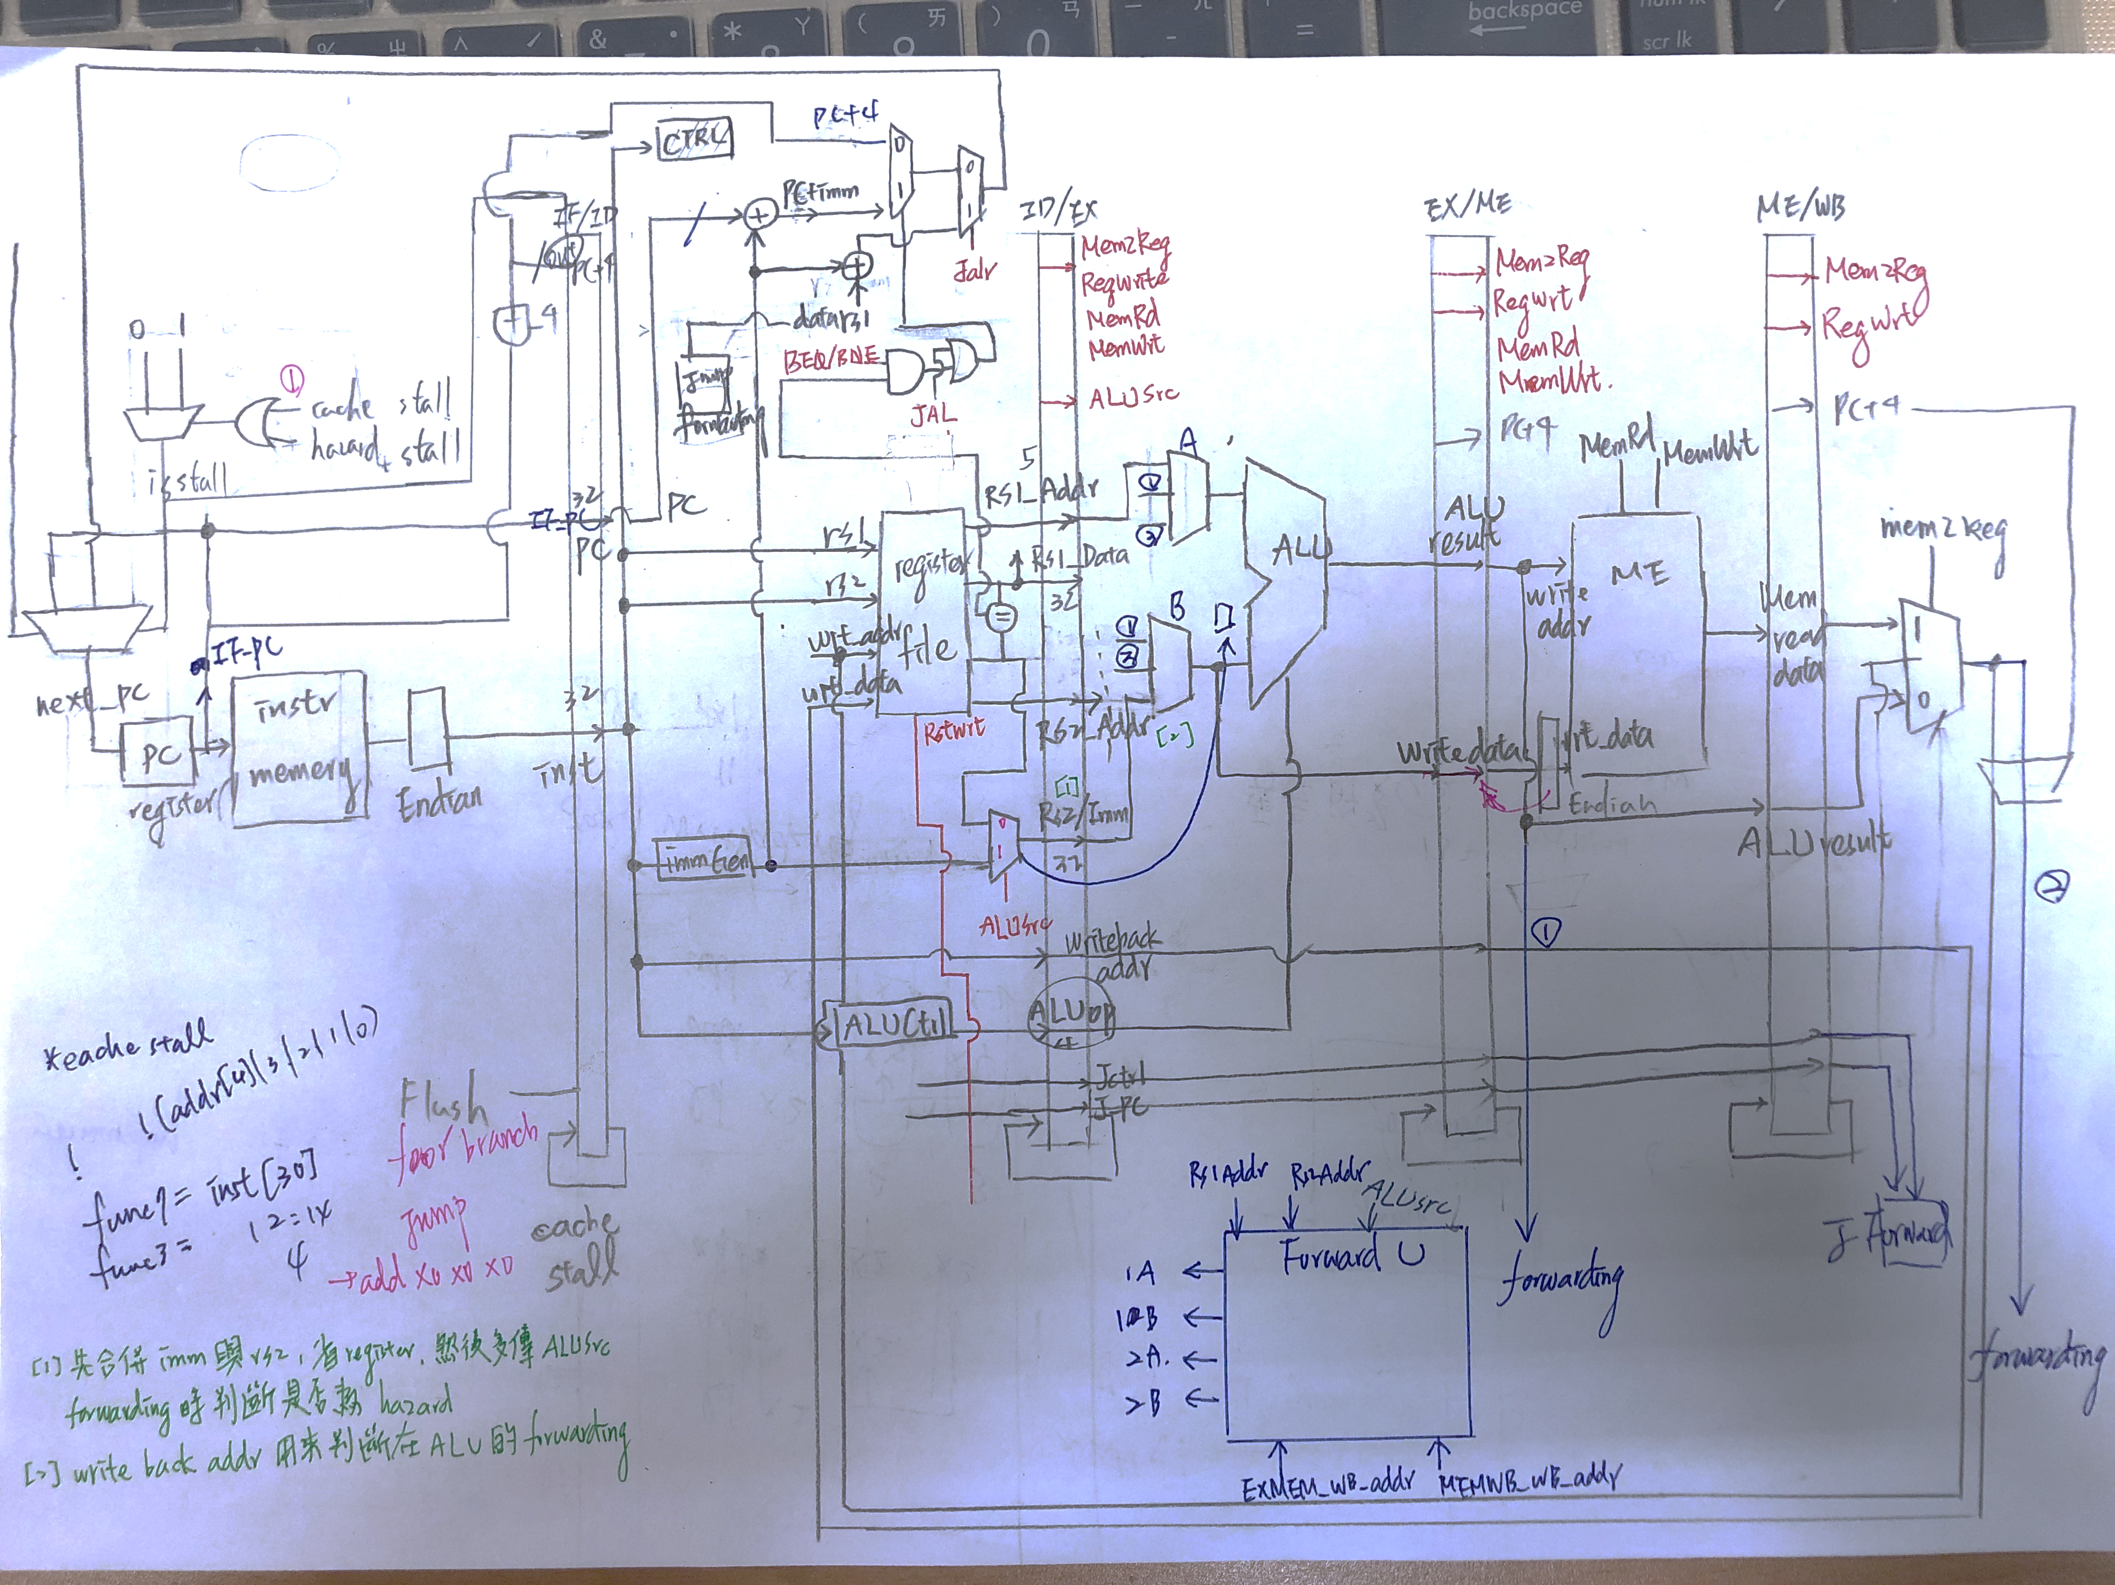
Baseline Structure V2

Slide 6
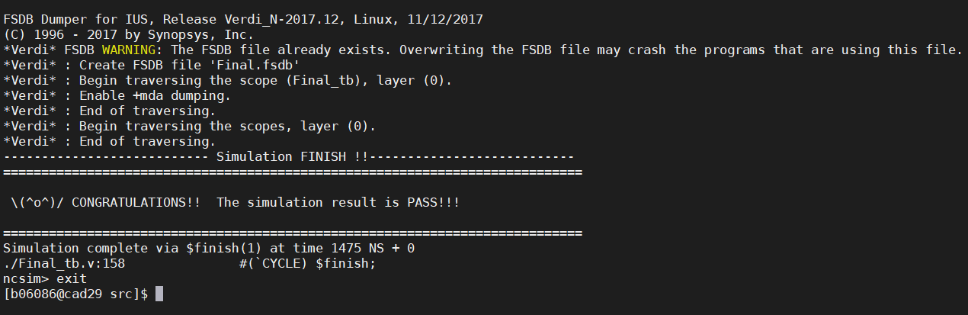
Baseline No Hazard

Slide 7
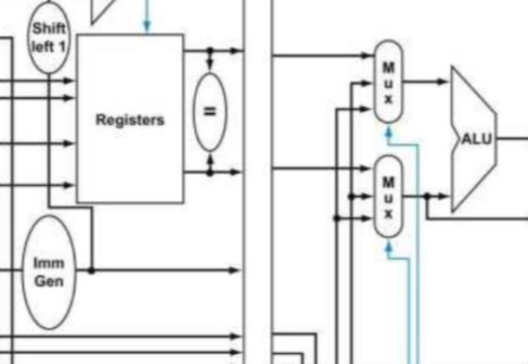
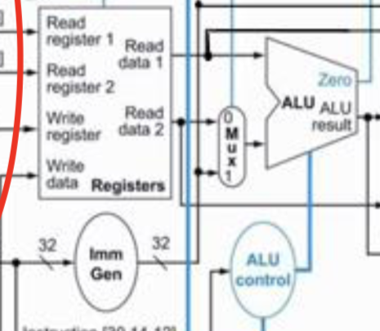
Some Faced Questions
Only Pass Imm or RS2 to Next Stage ?
Saving 32 bits of register???

Slide 8
Some Faced Questions
$signed(x) >>> $signed(y)
Shamt unsigned extension !
SLT signed
J type Design

Slide 9
Extension
Baseline
Enhancement
Compression
Prediction
L2 Cache

Slide 10

Baseline Enhancement
Redraw
KMAP
Shorten
Critical Path

Slide 11
Compression
R
16
Selector Swap
Initial : Right
32 / 16
32
Selector Remain
Left/Right
Selector
16
Selector Swap
32 / 16
L
32
Selector Remain
Save to
Buffer

Slide 12
Prediction
1 bit
predictor
2 bits
predictor
Comparison
Single
Predict
Error
Double
Predict
Errors

Slide 13
Cache
L1 Cache
L2 Cache
Write Back
Write Through
Through + Buffer
Directly Map
2 ways
4 ways

Slide 14
Timeline Assignment

Slide 15
Future Work
吳建翰
Cache Comparison
鄭謹譯
Compression
周光照
Prediction
Baseline Enhancement

Slide 16
Currently done
吳建翰
L2 Cache
Pipeline debug
鄭謹譯
Pipeline RISCV & debug
PPT
周光照
Hazard Unit
Pipeline debug
Baseline Enhancement

Slide 17
Thank You!
吳建翰、周光照、鄭謹譯
2020.06.11

